Slide 1
Popular Video Games Analysis
FCSB Group 2
Luisa, Prisca, Mei Ting

Slide 2

History of video games

Slide 3
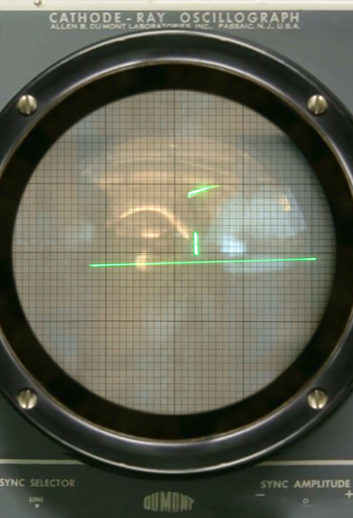
History
1958, 1st video game “Tennis For Two”
Various types of games being released concurrently
VR, AR, Indie Games
PC, Console, Arcade
Notes:
That’s Tennis For Two, the first video game created in October 1958, featuring moving graphics on an oscilloscope

Slide 4
Practical
Motivation
Notes:
We will be talking about our Practical Motivation of the project.

Slide 5



Motivation
2023
2024
32/day
12 000
2403
Notes:
As of now, there are video games being released everyday, catered to different kinds of audiences. In 2023, more than 12000 Steam games were released. That is 32 games being released each day. In 2024, there were 2403 games released so far since March 6 and more are in the making. With such high numbers, there is furious competition between companies and indie game creators when releasing their game and ensuring that their games succeeds in the gaming scene.

Slide 6
Problem Definition:
Identify patterns and trends in the evolution of video games over time and predict emerging genres and shifts in popularity for future developers to consider when developing a video game
Notes:
We would like to assist video game creators in creating successful games catered to the gaming community. Hence, we came up with the problem definition. We want to identify patterns and trends in the evolution of video games over time and predict emerging genres and shifts in popularity for future developers to consider when developing a video game.

Slide 7
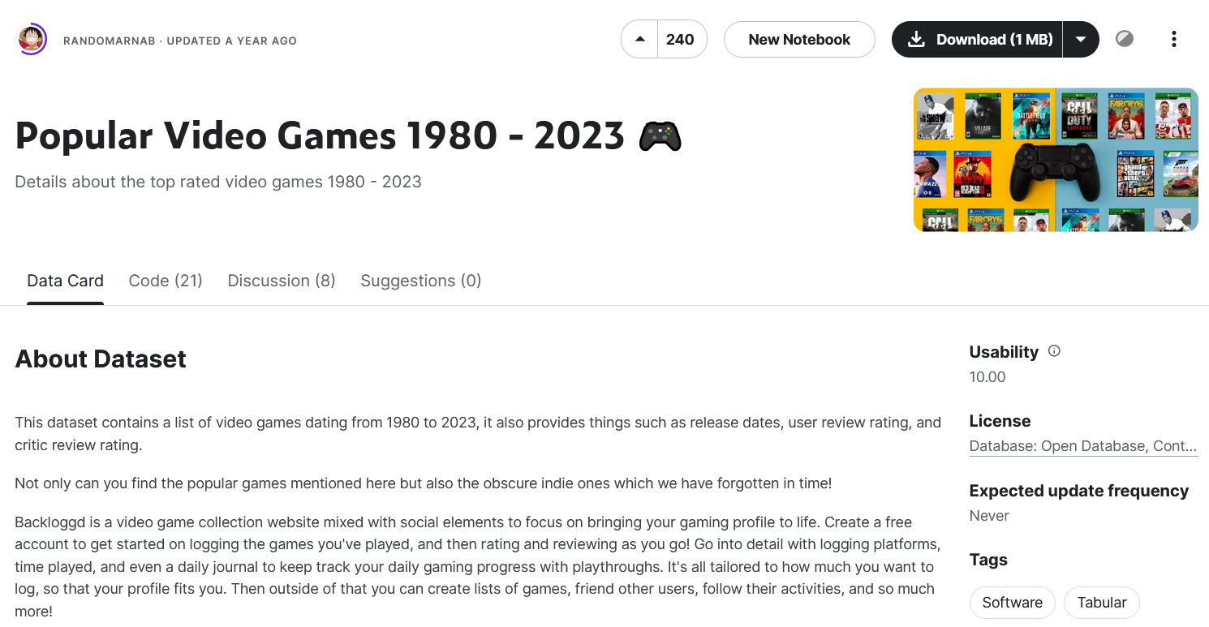
Our Dataset
Unique Columns
Rating
Genres
Summary
Reviews
Interested
Playing
Review count
Notes:
Our dataset is taken from Kaggle created last year titled Popular Video Games from 1980 to 2023. It consists of columns that we will be using later such as title, rating, genres, summary, reviews and interested.
Now, I will pass the time to Prisca who will be talking about the exploratory data analysis of our project.

Slide 8
Exploratory
Data Analysis

Slide 9
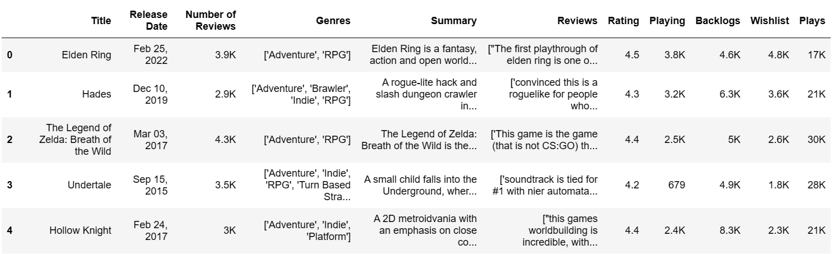
Cleaning of Dataset
Year
Interested
Drop null values
Notes:
Cleaning of data:
Remove all columns with null values
Combined ‘backlogs’ and ‘wishlist’ into 1 var, ‘interested’
Simplify release date to just year (no need specific dates, not useful)

Slide 10
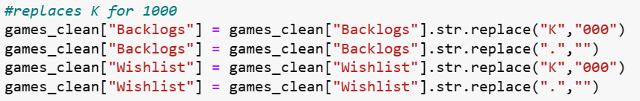
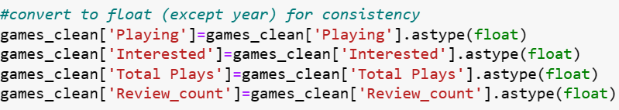
Change to numerical values
Change variable type
Notes:
All the numbers in string form such as ‘number of reviews’, ‘playing’ and ‘backlog’ -> change to int form by replacing K with thousand
Change variable type for consistency and easier manipulation later on

Slide 11
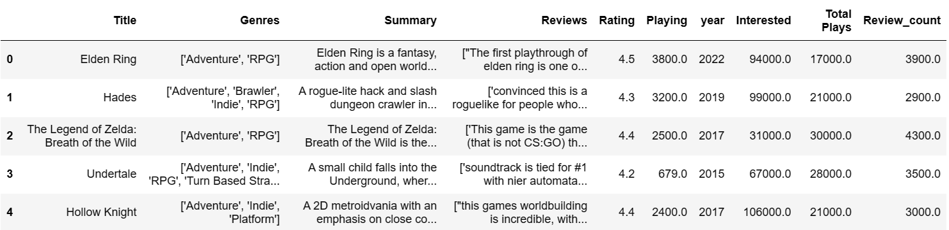

Slide 12

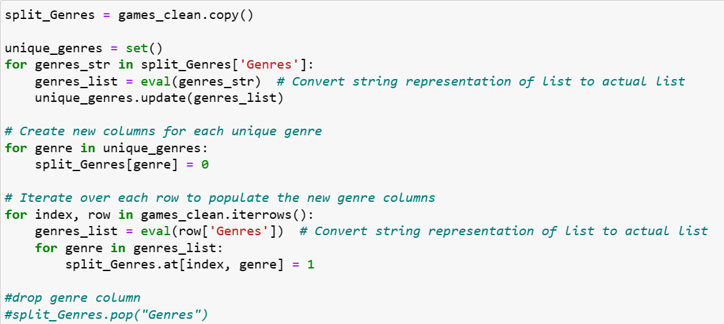
Split genres for easier analysis

Slide 13
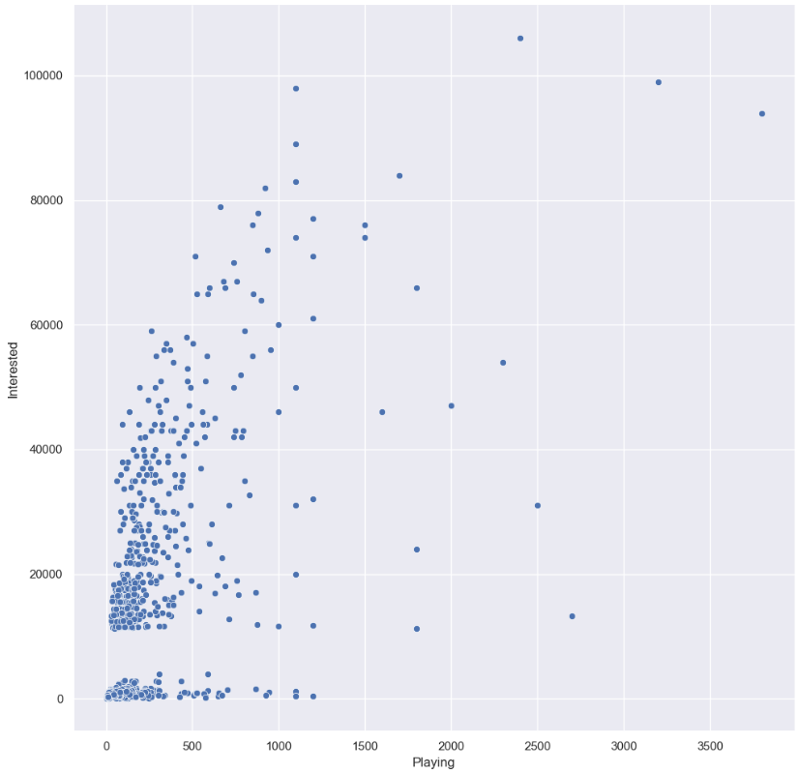
Data Analysis
Interested vs Playing
Coefficient = 0.650
Huge cluster of points near origin
Most games do not reach a large audience

Slide 14
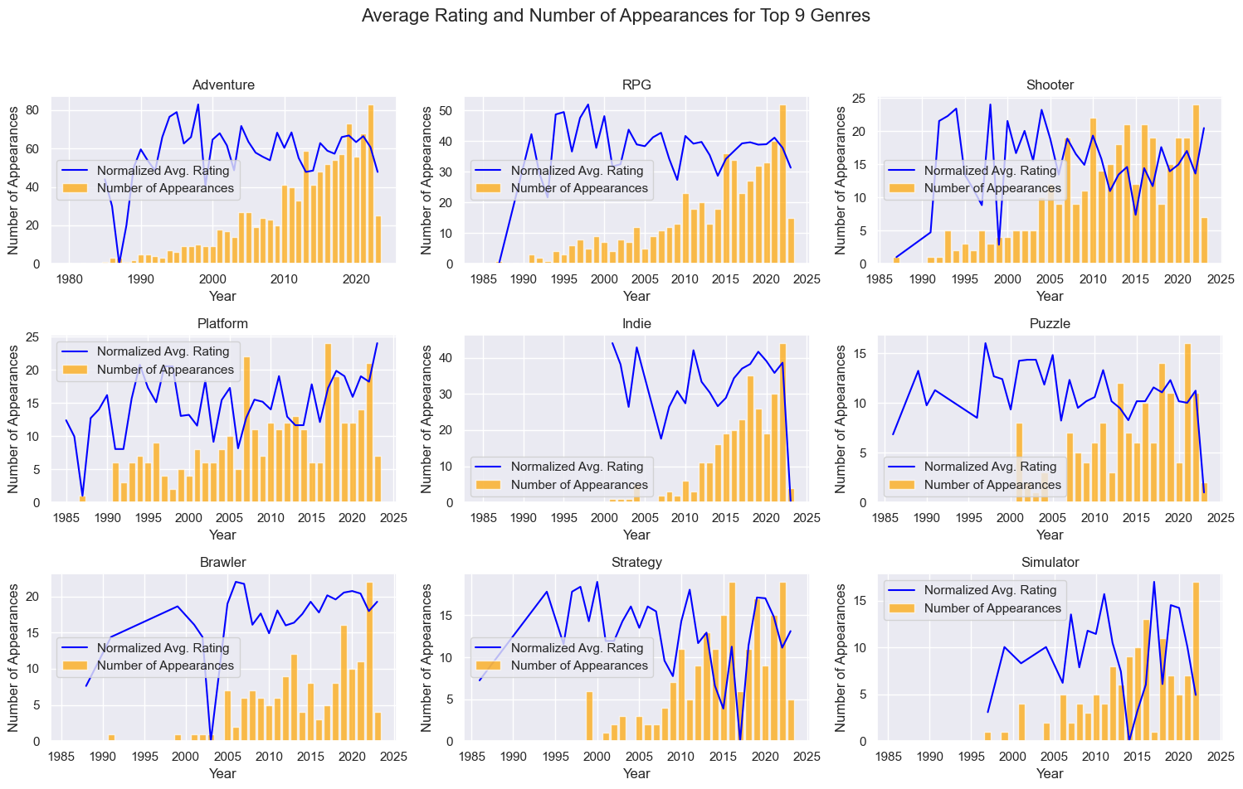
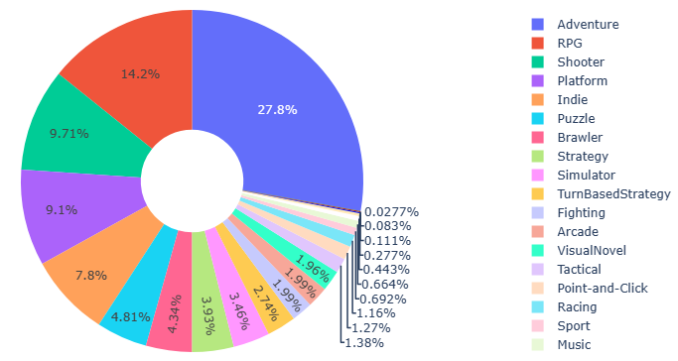

Slide 15
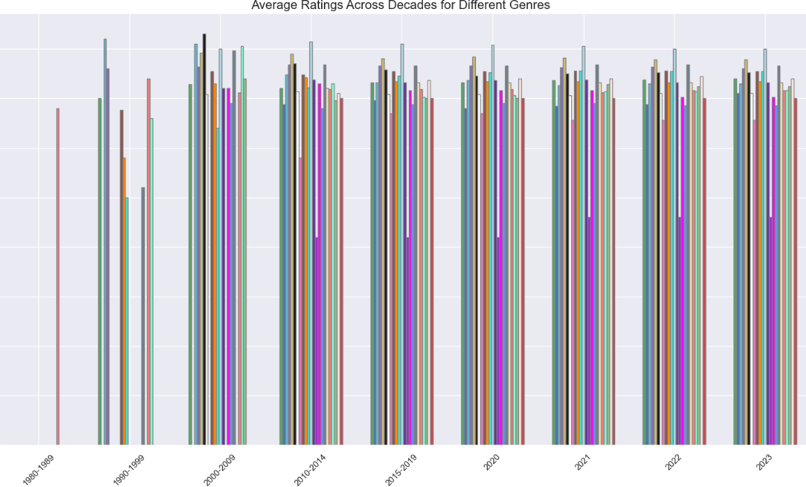
Adventure, Shooter
popular in gaming industry
niche genres like Visual Novel, Point-and-Click
can uncover market opportunities
Highest average rating since 2010s
Tactical, Strategy, RPG topped charts
ratings decreased across the years
more genres develop -> greater competition -> hard to maintain their ratings

Slide 16
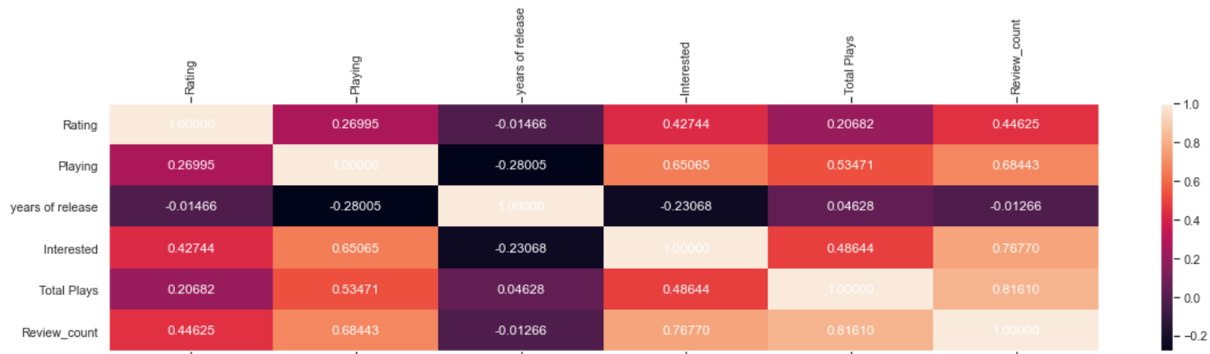
Heatmap of variables
Focus on strong correlation
Variables for machine learning

Slide 17
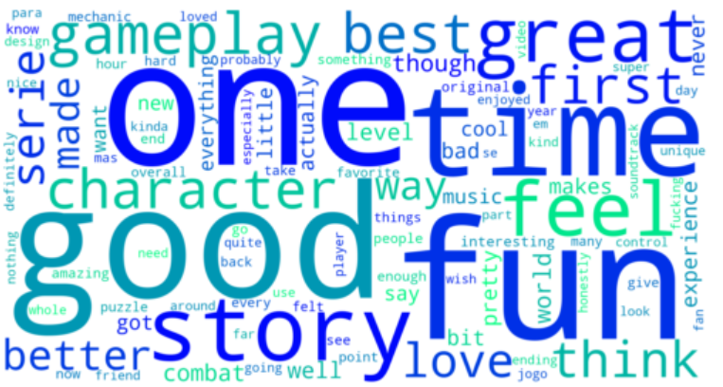
Reviews’ word cloud
Determine connotations
NLP TF-IDF

Slide 18
Natural Language Processing

Slide 19
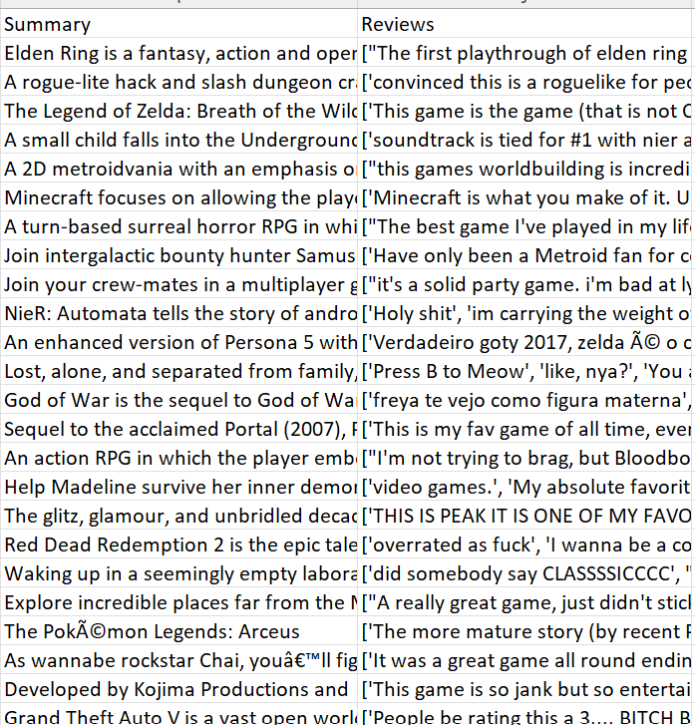
Unicode
Non-English reviews
Notes:
As you can see in the picture, the reviews and summaries have unicode and non-English reviews. To ensure our algorithm can analyse texts as part of its prediction of emerging genres, we will be using Natural Language Processing to clean the data.

Slide 20

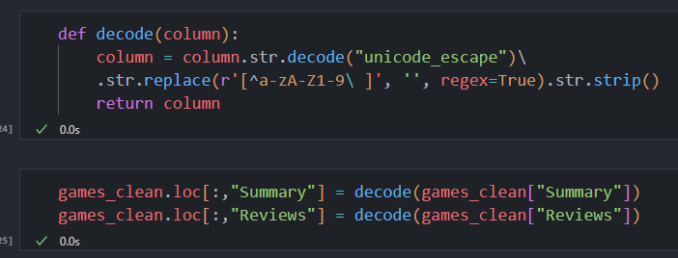
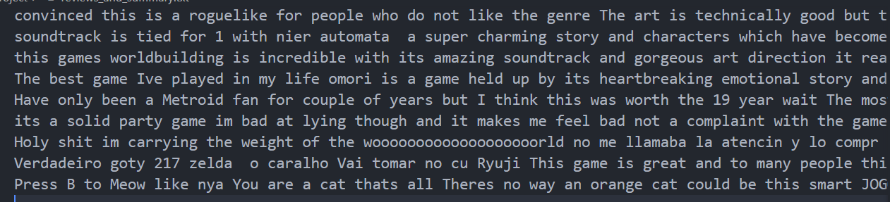
Removing unicode from summary & reviews
Notes:
First, we filtered out random unicode characters from the reviews and summary texts, giving us a clean string of texts.

Slide 21
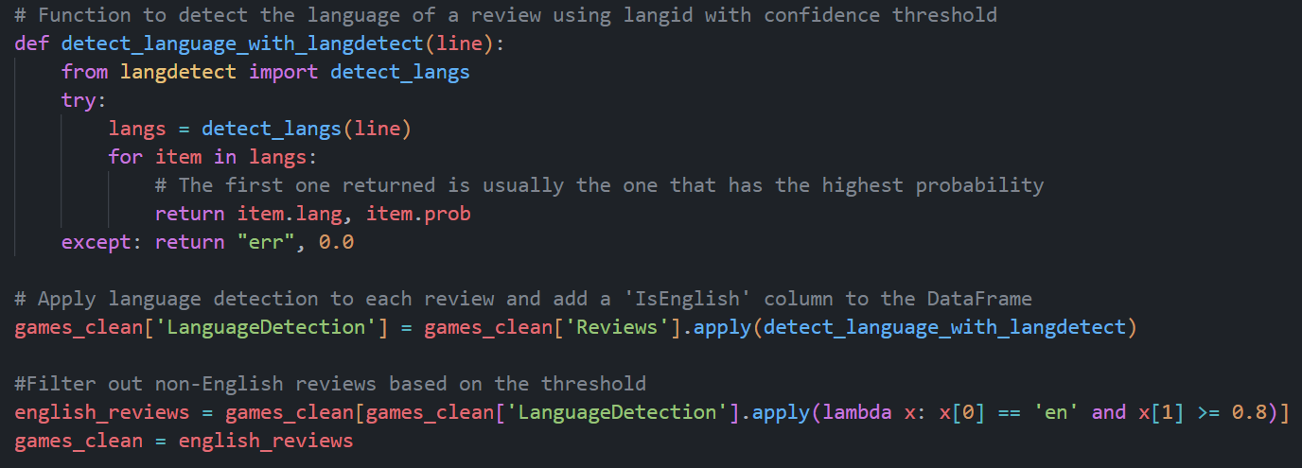
Filter reviews based on language
Notes:
Secondly, we removed games with reviews that were completely non-english. Games with English & other languages, mostly Spanish, reviews will still stay. We decided to not remove the spanish words as the sentiment values are still valid. This is because as long as the review contains english words, the sentiment analysis will still use those English words to evaluate if the reviews are positive or negative. Although some reviews may contain Spanish words, the sentiment values were still accurate, such as 1482 and Dragon Ball. Both contained Spanish words but the sentiment analysis still determined that the games were negatively reviewed. Hence, we decided that not much of a difference can be seen from before and after and decided to leave it in.

Slide 22
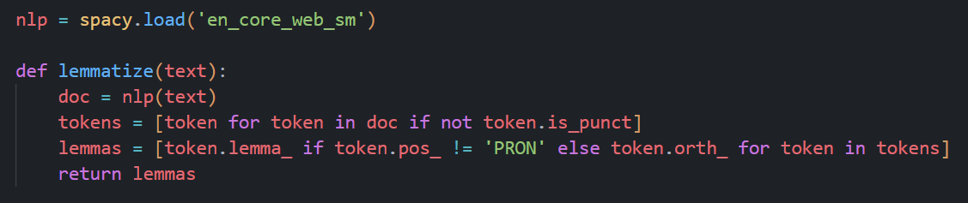
Lemmatize function
Notes:
Next, we move on to lemmatizing our summary and reviews with the lemmatize function.
It processes incoming data using Spacy, a python library, to determine the base form of each word in summary and review. Then, it returns a list of those words in base form, known as lemmatized words. Lemmatized words are in a singular form, such as “building” and “builds” turning into “build”. This allows words to be broken down to allow the algorithm to identify similarities easily and generate more accurate results. It is used in generating TF-IDF matrix, which will be explained later.

Slide 23
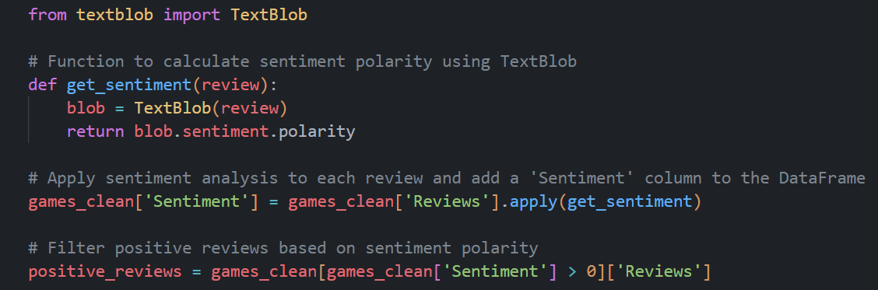
Sentiment Value using TextBlob
> 0 sentiment value
=
Positive Review
Notes:
After that, we did sentiment analysis using TextBlob, another python library, to determine if the reviews were positive or negative. Any sentiment value that is above 0 indicates a positive review. Anything below 0 indicates a negative review.

Slide 24
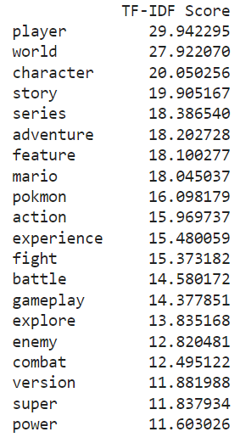
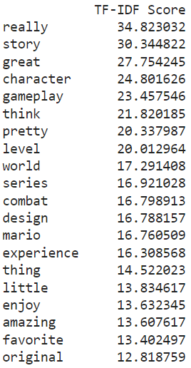
TF-IDF
Summary from positive reviews
Positive reviews
Notes:
After using sentiment analysis to split the reviews into positive and negative, we converted our text data to TF-IDF vectors and gathered the TF-IDF scores as seen in the slides. TF-IDF is a measure that evaluates how relevant a word is to a document in a collection of documents. It increases proportionally to the number of times a word appears in a document, but is offset by the number of documents that contain the word. Example: Words that are common in every document, such as this, what, are rank low even though they may appear many times, since they are not relevant to that document. We decided to use TF-IDF to determine the top 20 common words that are relevant in positive and negative reviews. We also decided to use summaries from the reviews to gather more information on the description of the positively and negatively reviewed games to see if there is any correlation of words between the reviewed games and their summaries. Instead of just using reviewed games, by combining it with its summary, it will give us a more concrete result. As you can see in this slide, these are the top 20 common and relevant words that appear in positive reviews and summary from positively reviewed games.
From this, we understand that players lean more towards games with well-written characters and stories, while some games may not be favoured if those elements were not up to their expectations.
Next, I will pass the time to Luisa who will talk more about Machine Learning.

Slide 25
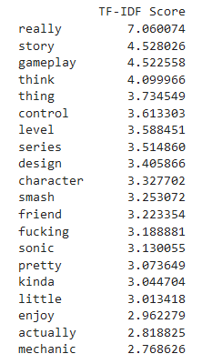
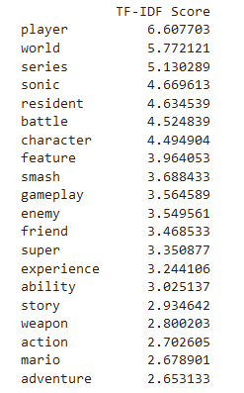
TF-IDF
Summary from negative reviews
Negative reviews

Slide 26
Machine Learning

Slide 27
1
2
Clustering
Logistics
Regression
Notes:
For our machine learning, we used 2 main types. Logistics regression as well as clustering.

Slide 28
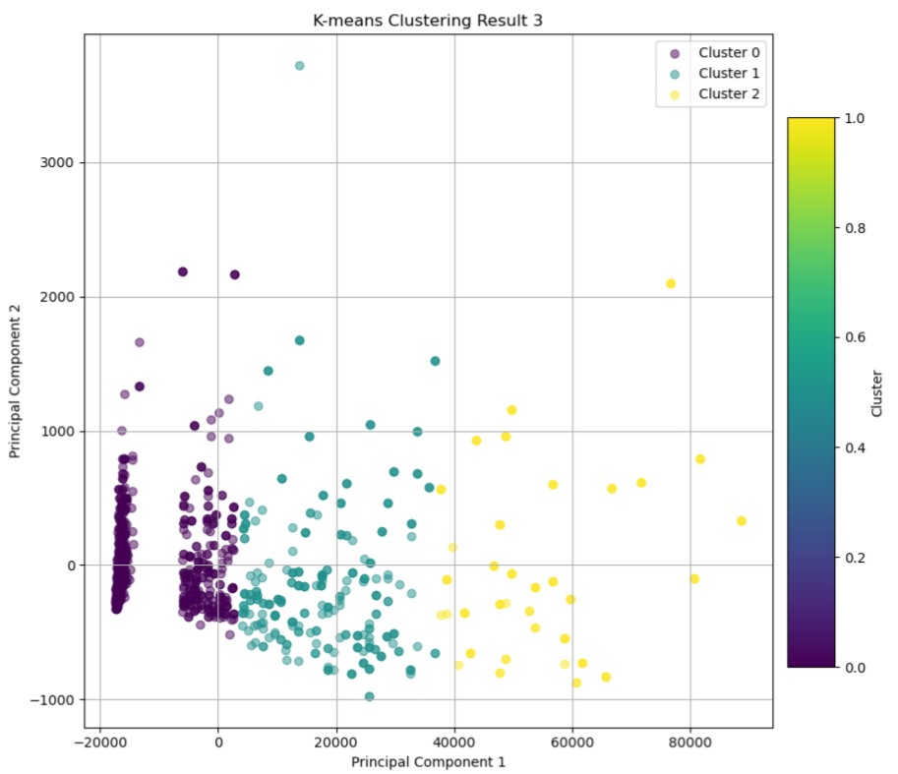
Clustering Model
Clustering was used to make categorical clusters with similar data points based on numerical features
Numerical variables that could be used to indicate player engagement (E.g Rating of game) with at least an R=0.65 were used as features
3 groups (a Categorical variable)
A Scatterplot graph was used to help us visualise the clusters and their seperation
Notes:
For this model, we made 3 clusters with KMEANS algorithm using numerical variables that are indicators of player engagement with moderate correlation with one another like interested and playing
A Scatterplot graph was used to help us visualise the clusters and their seperation

Slide 29
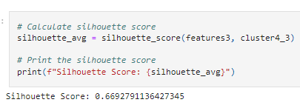
Analysis of Clustering Model
Silhouette score of final clustering model: 0.67
A silhouette score of 0.67 suggests that the clustering is reasonably good, as it indicates that the data points are well-clustered with minimal overlap.
Notes:
A silhouette score of 0.67 suggests that the clustering is reasonably good, as it indicates that the data points are well-clustered with minimal overlap.
Silhouette scores help to measure how well separated the clusters are.

Slide 30
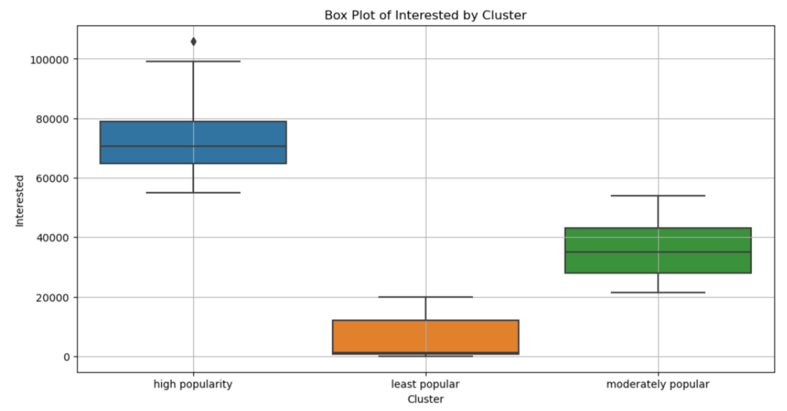
Analysis of Clustering Model
,
Rating, Interested, Playing, Review Count
Box plots were used to visualise how well separated each features used in clustering were
Notes:
For our final clustering model, we used the variables Rating, interested, review counting and playing
Box plots were used to visual how well separated each features were.

Slide 31
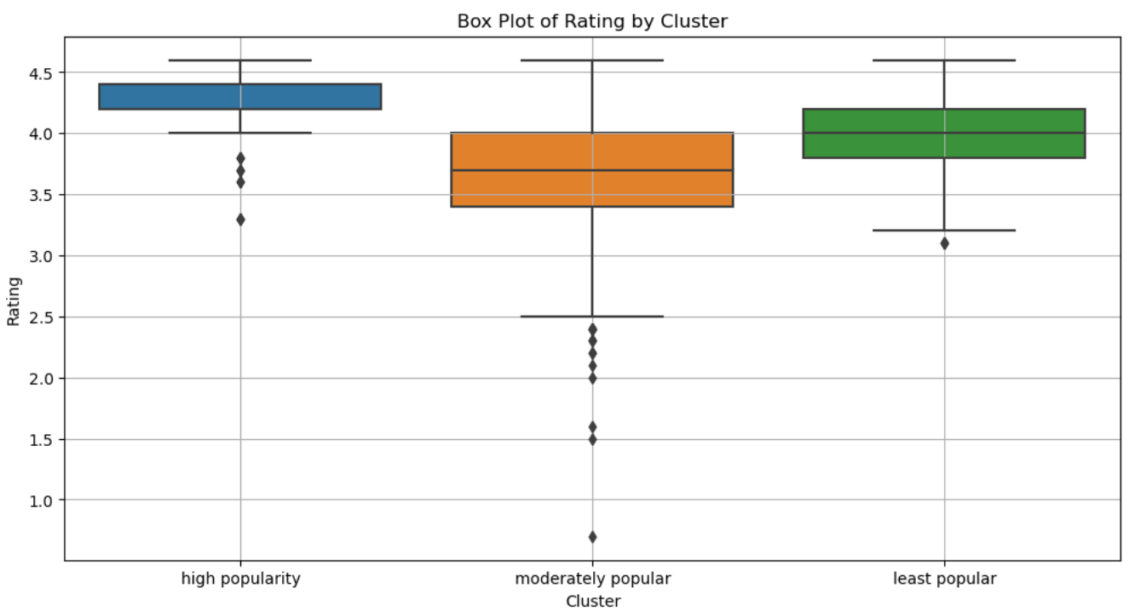
Analysis of Clustering Model
Least: little player engagement and interest, low ratings
Moderate: growth potential; moderate player engagement and interest, high rating
High: high engagement and interest, high ratings
Notes:
These classes represent the 3 levels of game popularity. For example, the group, high popularity representing high engagement , interest and high ratings

Slide 32
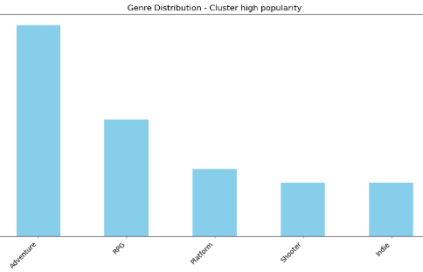
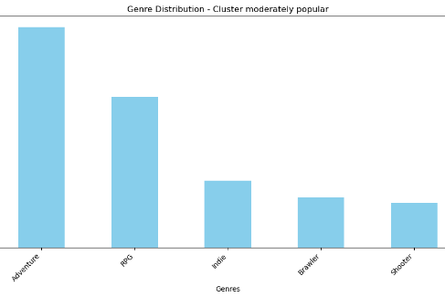
Top 5 Genres from Cluster
We took the top 5 genres for each cluster to evaluate the individual genres
Insight on which Genres would make a game popular
Notes:
To get insights from clustering…

Slide 33
Analysis of Clustering Model
Advantage
Disadvantage
Made clusters based on player engagement indicators
Useful to understand genre preferences for each group
Inaccurate/unclear predictions for which genres will make the game popular
Challenging to evaluate the effectiveness of this model to predict popular game genre
Notes:
While the clustering model was useful to help us understand the genre preference for different levels of popularity,, there was no clear predictions which made it challenging to get clear insights. Hence we decided to use LR

Slide 34
Logistic Regression
Logistic Regression was used to predict what content in games (From TF-IDF features of Summary of the games) belongs to which category of popularity (High, Moderate and Low)
Class-wise metrics, ROC Curve(assess the model's ability to correctly classify true positives while minimizing false positives.) and Precision-Recall Curve was used to visual and evaluate the performance of the model

Slide 35
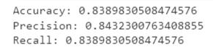
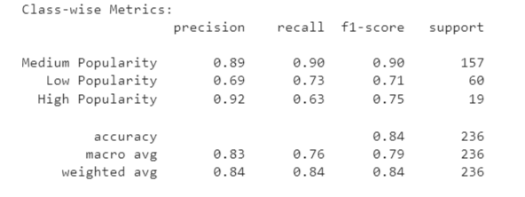
Logistics Regression Performance
Overall, Model shows decent performance in accurately predicting the popularity categories of video games based on their summary text with Precision=0.84
A weighted score=0.84 for all metrics indicates that model's predictions are accurate and reliable for the dataset as a whole, taking into account the distribution of instances (due to class imbalance) across different popularity categories.
Notes:
Overall, Model shows good performance with the all the metrics being around 0.8
We also checked the metrics for each individual class, since there was a class imbalncce, A weight score that takes this into account is 0.84 which shows the model is reliable as a whole

Slide 36
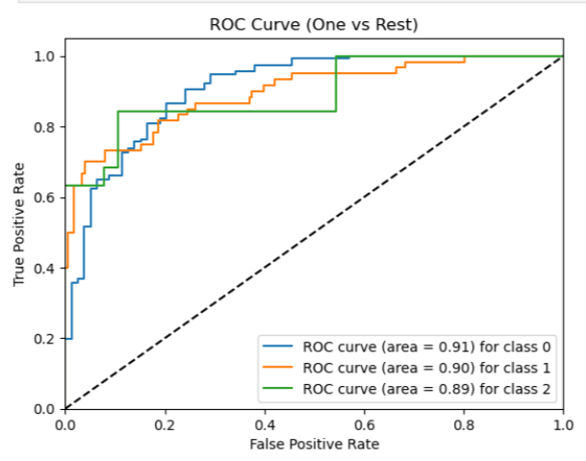
Logistics Regression Performance
Accesses the model's ability to correctly classify true positives while minimizing false positives.
High AUC scores
It indicates that the model can effectively separate high popularity games from other 2 clusters

Slide 37
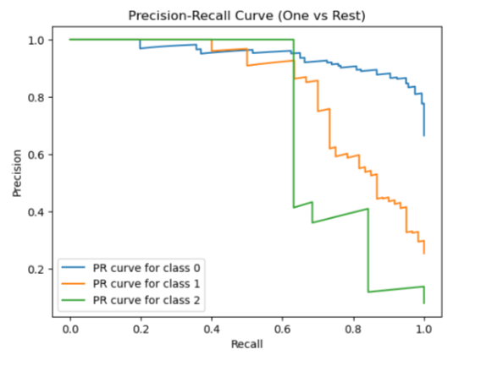
Logistics Regression Performance
A precision-recall curve with this shape shows model is capable of making trade-offs between precision and recall
Model is flexible and adaptable according to the needs of the application.
Notes:
For example predicting game popularity requires high precision with low recal to ensure model correctly identifies popular games with a low rate of FP
A precision-recall curve showing high precision at low recall and vice versa shows that the model is capable of making trade-offs between precision and recall

Slide 38
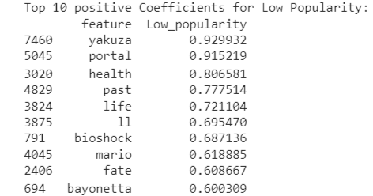
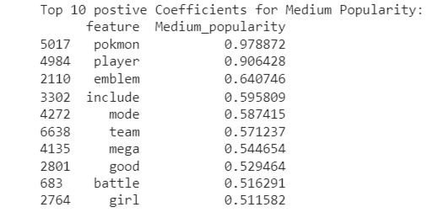
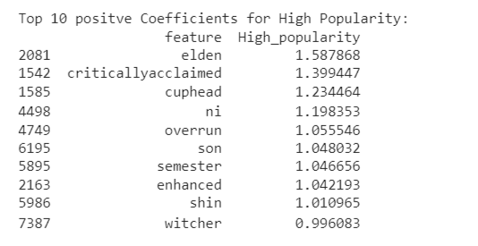
Top 10 Features Predicted
These are the words that are mostly associated to the game respectively in each classes
For example, we can infer that games with yakuza content are most likely going to be unpopular while games with perhaps witcher content are most likely to be popular
We can gain a deeper understanding by identifying the genres that are associated with the top 10 features in high popularity class
Notes:
Then we decided to take the 10 features associated to each cluster’s level of popularity
to get insights to what kind of content would make a game popular or unpopular
For example, ifth egame has yakuza content, game might not become popular

Slide 39
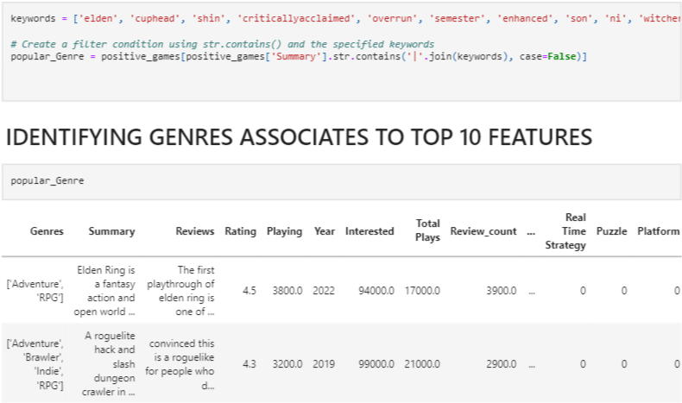
Filter Dataframe accordingly
Notes:
Filtered the dataframe to only contain games associated with the top 10 features

Slide 40
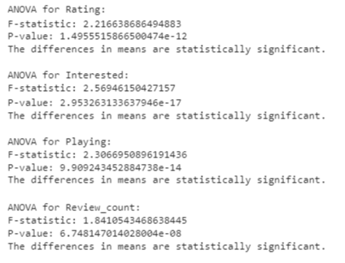
Analysis of Variance (ANOVA)
We used Analysis of Variance (ANOVA) to first check if there is a possible relationship between the numerical variables and the genres of the games
In hypothesis testing, the significance level, often denoted by α (alpha), is typically set to 0.05.
Since the p-values o the all the variables are more than 0.05, these variables all have a possibles relationship with genres
Now we can use them to get the top 20 genres from the filtered dataframe
Notes:
First we had to use ANOVA to check if all the numerical variables used in clustering has a possible relationship with genres
Since they all had p-values of 0.05, they all had relationships,.
Now we can use this to get top 20 genres respective to these 4 variables

Slide 41
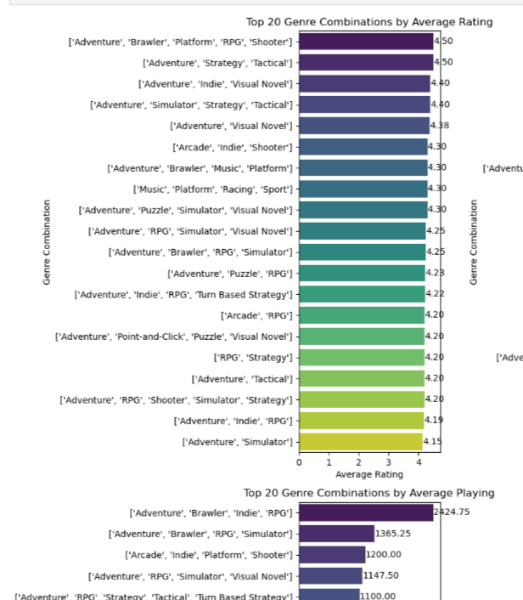
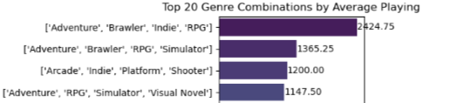
Top 20 Genres
Overlapping genre combinations
Can pinpoint the genres that consistently perform well across multiple metrics such as rating, interest, current playing and review count.
This approach allows me to focus on genre combinations that have a broad appeal and are likely to attract a diverse audience.
Notes:
We noticed overlapping genres and used those to focus on genre combinations that have broad appeal

Slide 42
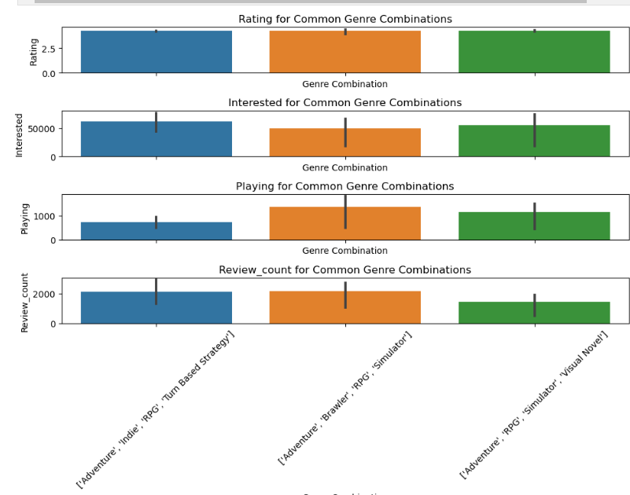
Popular Genre combinations
Notes:
AS you can see, we obtained 3 overlapping genres combi

Slide 43
Popular Genre combinations
[Adventure, Indie, RPG, Turn Based Strategy]: Games in this category typically offer players the opportunity to explore immersive worlds with player-driven choices. The Indie aspect suggests a game developed with creative freedom and unique artistic vision might lead to unique game mechanics.
[Adventure, Brawler, RPG, simulator]: Games in this category offer a mix of dynamic gameplay, narrative depth, and realistic simulation
[Arcade, RPG, Visual Novel, simulator]: Games featuring these elements offer a blend of nostalgic arcade fun, rich storytelling, and immersive simulation, appealing to players looking for diverse and engaging gaming experiences.
Notes:
we were able to get insights on what content would be popualr

Slide 44
Conclusion

Slide 45
Conclusion
With all of these conclusions, game creators can have a better idea of what elements the community is looking out for in games currently that will captivate them to play and enjoy themselves. This will allow the interested audience to play the games and gain popularity from there.

Slide 46
Project Outcome
What we learned:
Utilisation of visualisation tools such as word clouds, bar-line charts, pie charts etc.
Natural Language Processing, TextBlob, TF-IDF
Cleaning of language
Logistic regression, clustering models
Outcome: Game developers/Companies
Predict if their games are popular based on the content in the summary of their game
Extract Genres that are popular at the moment

Slide 47
Data Driven Insights (Clustering)
Game developers can leverage on growing popularity of Brawler genre
Create games catering to players interested in dynamic combat and multiplayer interactions (Cluster insight)
Consistent appearance of genres like Adventure and RPG in top combinations suggests a preference for immersive storytelling and character-driven gameplay.
Developers can build upon the established elements of these genres to create new and innovative gaming experiences with other genres.
Notes:
From clustering, Game dev…
Use consistently popular genres rpg and edventure

Slide 48
Data Driven Insights (LR)
Game developers are encouraged to create games with a blend of genres, incorporating Adventure and RPG alongside Brawler, Simulation, Arcade and Visual Novels.
Can lead to development of more unique and diverse gaming experiences, catering to a broader audience
For example, integrating the Arcade genre into an RPG with storytelling features appeals to players seeking both narrative-driven experiences and nostalgic elements.
This approach ensures that games offer diverse and unique experiences, meeting the varied tastes and interests of modern gamers.
Some seem to negatively review games where these expectations aren't met

Slide 49
Conclusion
With all of these conclusions, game creators can have a better idea of what elements the community is looking out for in games currently that will captivate them to play and enjoy themselves. This will allow the interested audience to play the games and gain popularity from there.

Slide 50
THANK YOU

Slide 51


